Slide 1
DXC Redrock
Oracle Digital Assistants
Joy Pinto - Senior Technical Consultant
David Van Der Wende - Solution Principal

Slide 2
Transform your future of work
1
Natural Conversation
2
Why Oracle Digital Assistant
No App to Download
3
Available 24/7/365
4
Multiple Channels

Slide 3
Transform your future of work
1
Natural Conversation
2
Why Oracle Digital Assistant
No App to Download
3
Available 24/7/365
4
Multiple Channels

Slide 4
Transform your future of work
1
Natural Conversation
2
Why Oracle Digital Assistant
No App to Download
3
Available 24/7/365
4
Multiple Channels

Slide 5
Transform your future of work
1
Natural Conversation
2
Why Oracle Digital Assistant
No App to Download
3
Available 24/7/365
4
Multiple Channels

Slide 6
Transform your future of work
1
Natural Conversation
2
Why Oracle Digital Assistant
No App to Download
3
Available 24/7/365
4
Multiple Channels

Slide 7

Three-peat!
Named a leader in Gartner Magic Quadrant
Multi-Experience Development Platforms, MXDP, 2019*
Mobile Apps Development Platforms, MADP, 2018
Mobile Apps Development Platforms, MADP, 2017
* In 2019, Gartner MADP report was renamed to MXDP
Notes:
Historically speaking, prior to MXDP, its predecessor was Mobile Application Development Platforms (MADP), of which, Oracle was also “named a leader” for the previous 2 years, back to back and hence the 3-peat. Gartner recognized that market trends were changing and the previous title was too focused on mobile and needed to be updated to reflect evolving trends that reached beyond mobile and include progressive web apps, conversational apps (chatbots) and immersive apps (AR/VR) - as the types of apps people were using to engage businesses. We absolutely agree – especially considering the growth in AI powered conversational interfaces

Slide 8
One digital assistant for your enterprise
IT operations/Help desk
Answer employees’ common queries and free-up staff resources to focus on more important tasks.
Customer service
Offer 24X7, easy access to frequently asked questions (FAQs) and automate customer service engagements.
HR/Employee self-service
Empower employees with conversational access to self-service processes from anywhere, on any device.

Slide 9
Why choose Redrock ?
ODA for Oracle Classic Apps
1
ODA for Third Party Integrations
2
Voice based ODA
3

Slide 10
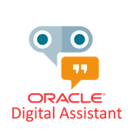




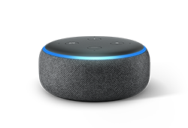
One digital assistant for your business
SaaS or On-Premises
Application

Slide 11
Demo – Hospital appointment booking integration
Initiate
Converse
Narrate
Book

Slide 12
Thank you.

